Slide 1
EmergencyAlerter
Arlinda Butja
Florian Mayerhofer
Michael Stifter
IMS16

Slide 2

Idea
Oh no, not again!
Capabilities of a Smartwatch

Slide 3

Persona
Susan
Susan is an exchange student, who studies Industrial Design. She comes from United States of America and is very enthusiastic about getting to know new people and being part of the 6-months exchange program. She also likes to party.
She had an unpleasant experience coming home from a party, when she run into the beautiful city park. Such an app would help Susanne a lot in case of trouble.

Slide 4

Persona
Klaus
Klaus is a father of two children and is very protective about them. He is always anxious that something could happen to them. Although they have smartphones he is worried they might not be able to contact him when they are in trouble.
With the Emergency Alerter Smartwatch app, the children only would have to tap one button to instantly notify the police or their father, which would help Klaus relax a little more.

Slide 5
User Stories
As a user, I want to be able to notify a pre-defined list of contacts that I need help, together with my last-known location with the tap of one button.
As a user, I want to be able to call the police with the tap of one button.

Slide 6
User Stories ctd.
As a user, I want to see how far away the nearest police station is.
As a user, I want my emergency contacts to be alerted in case my heart stops or the heartrate rises above a pre-defined threshold.

Slide 7
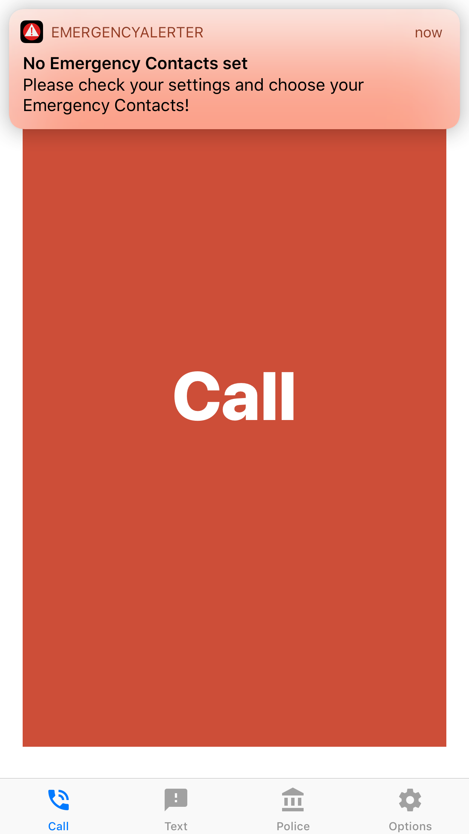
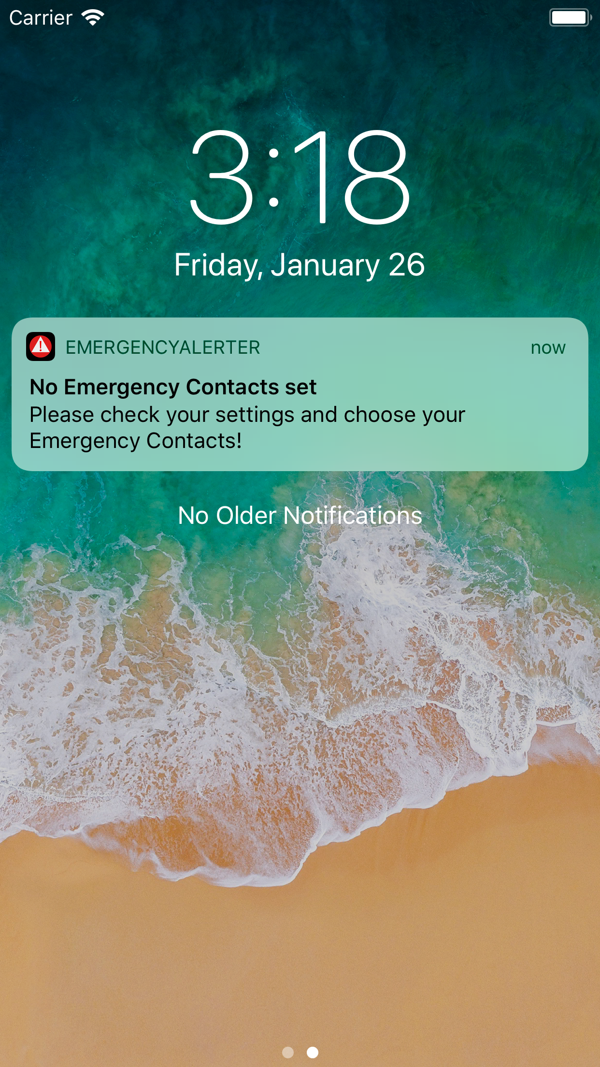
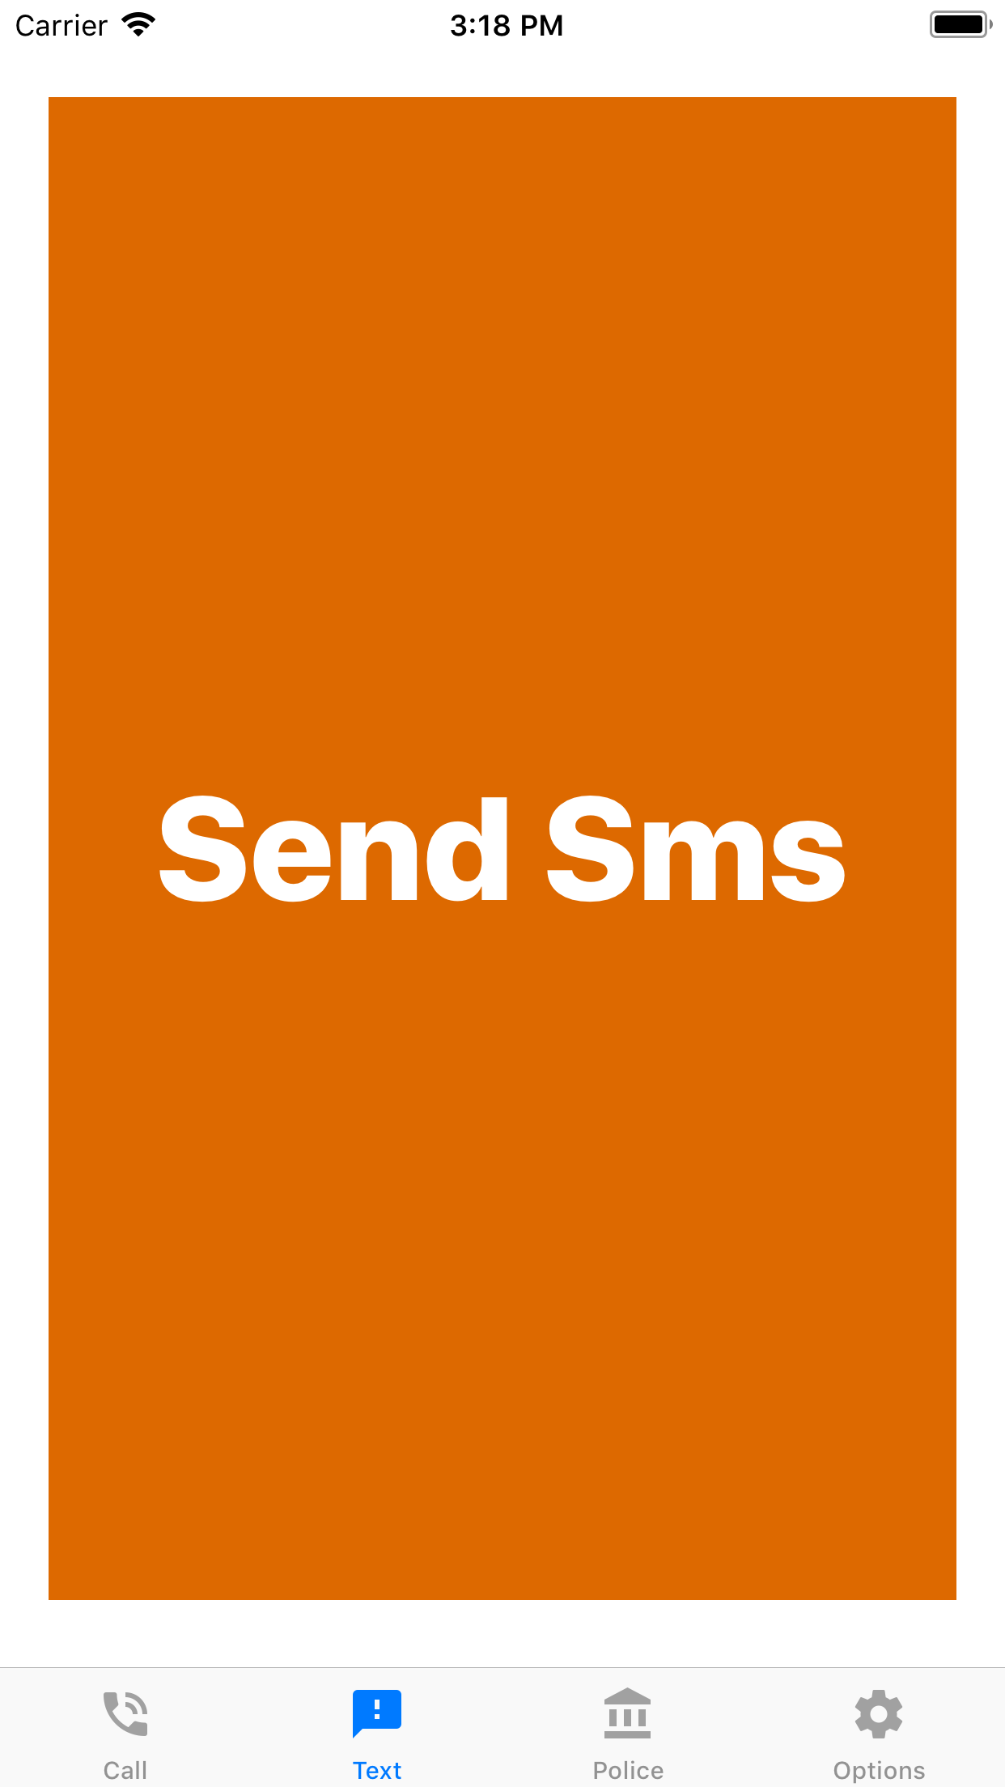

Slide 8
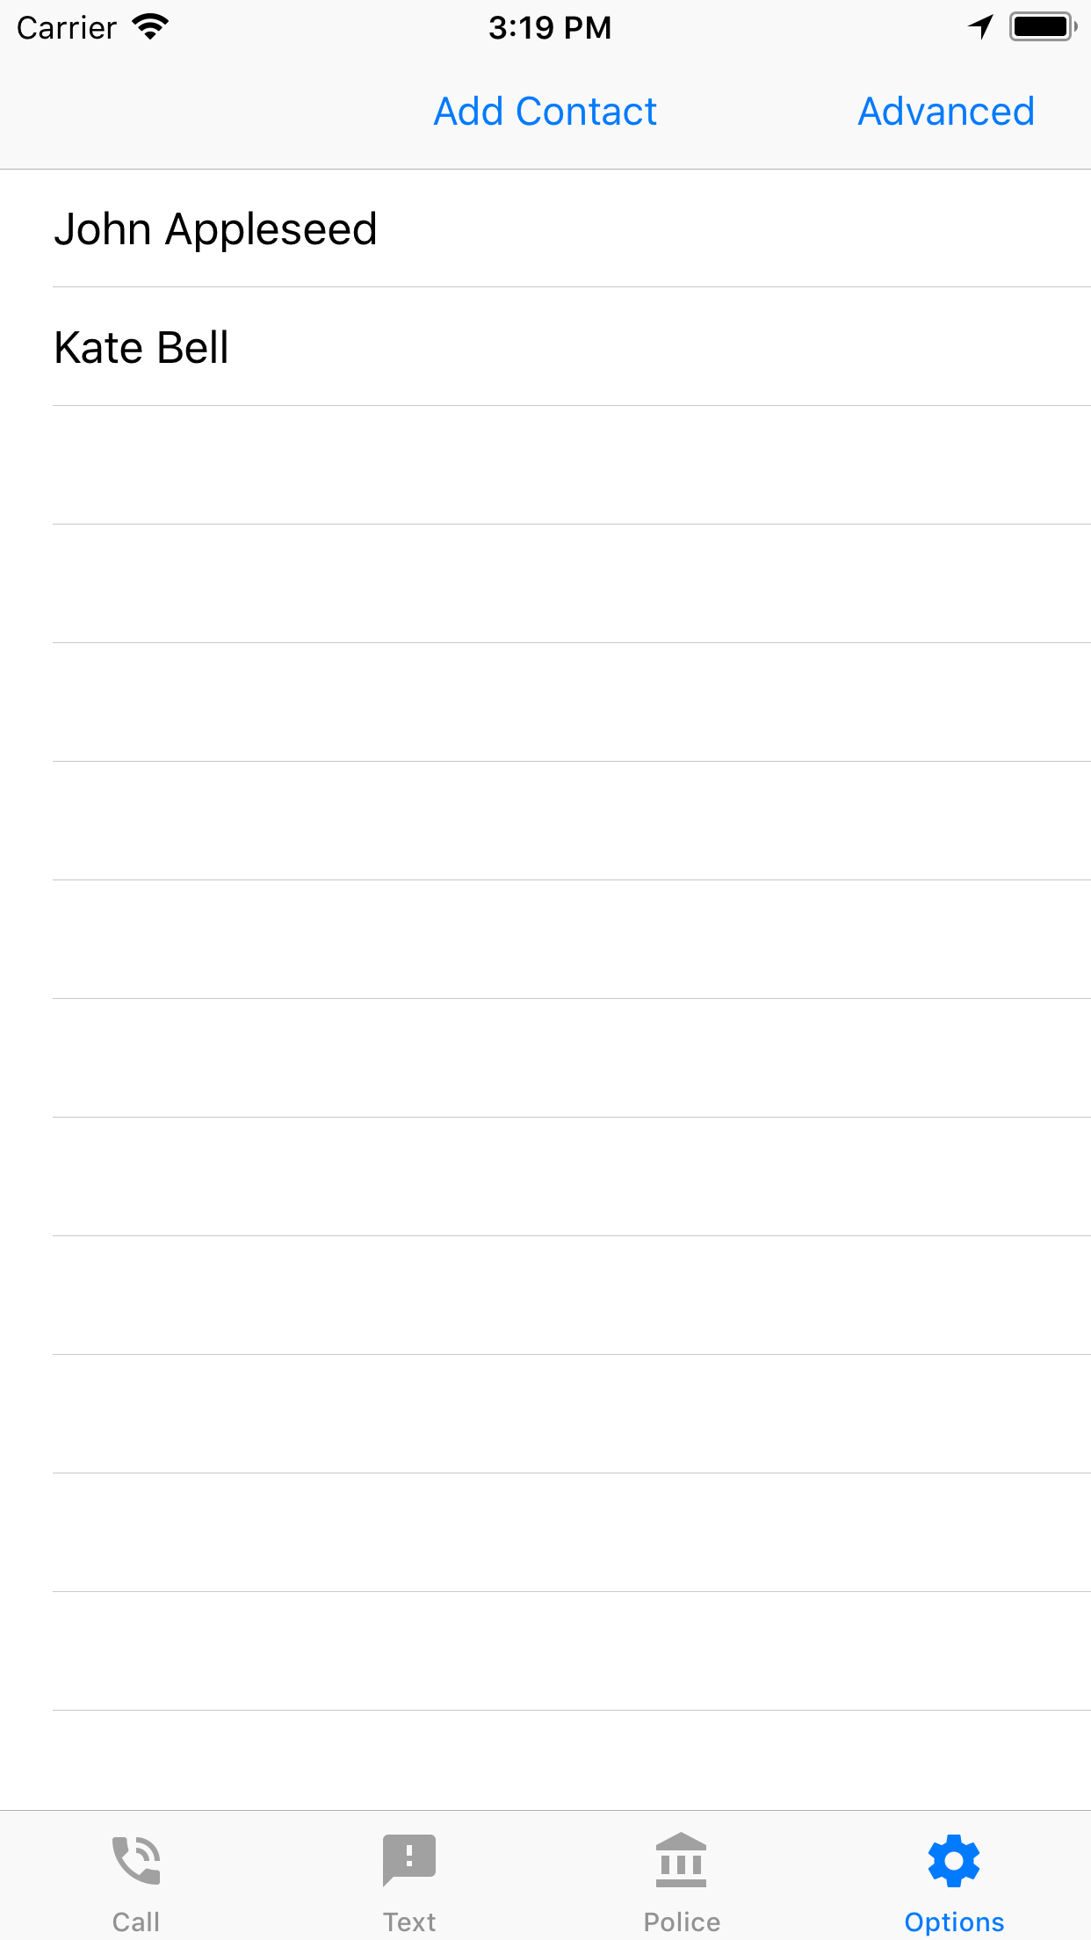
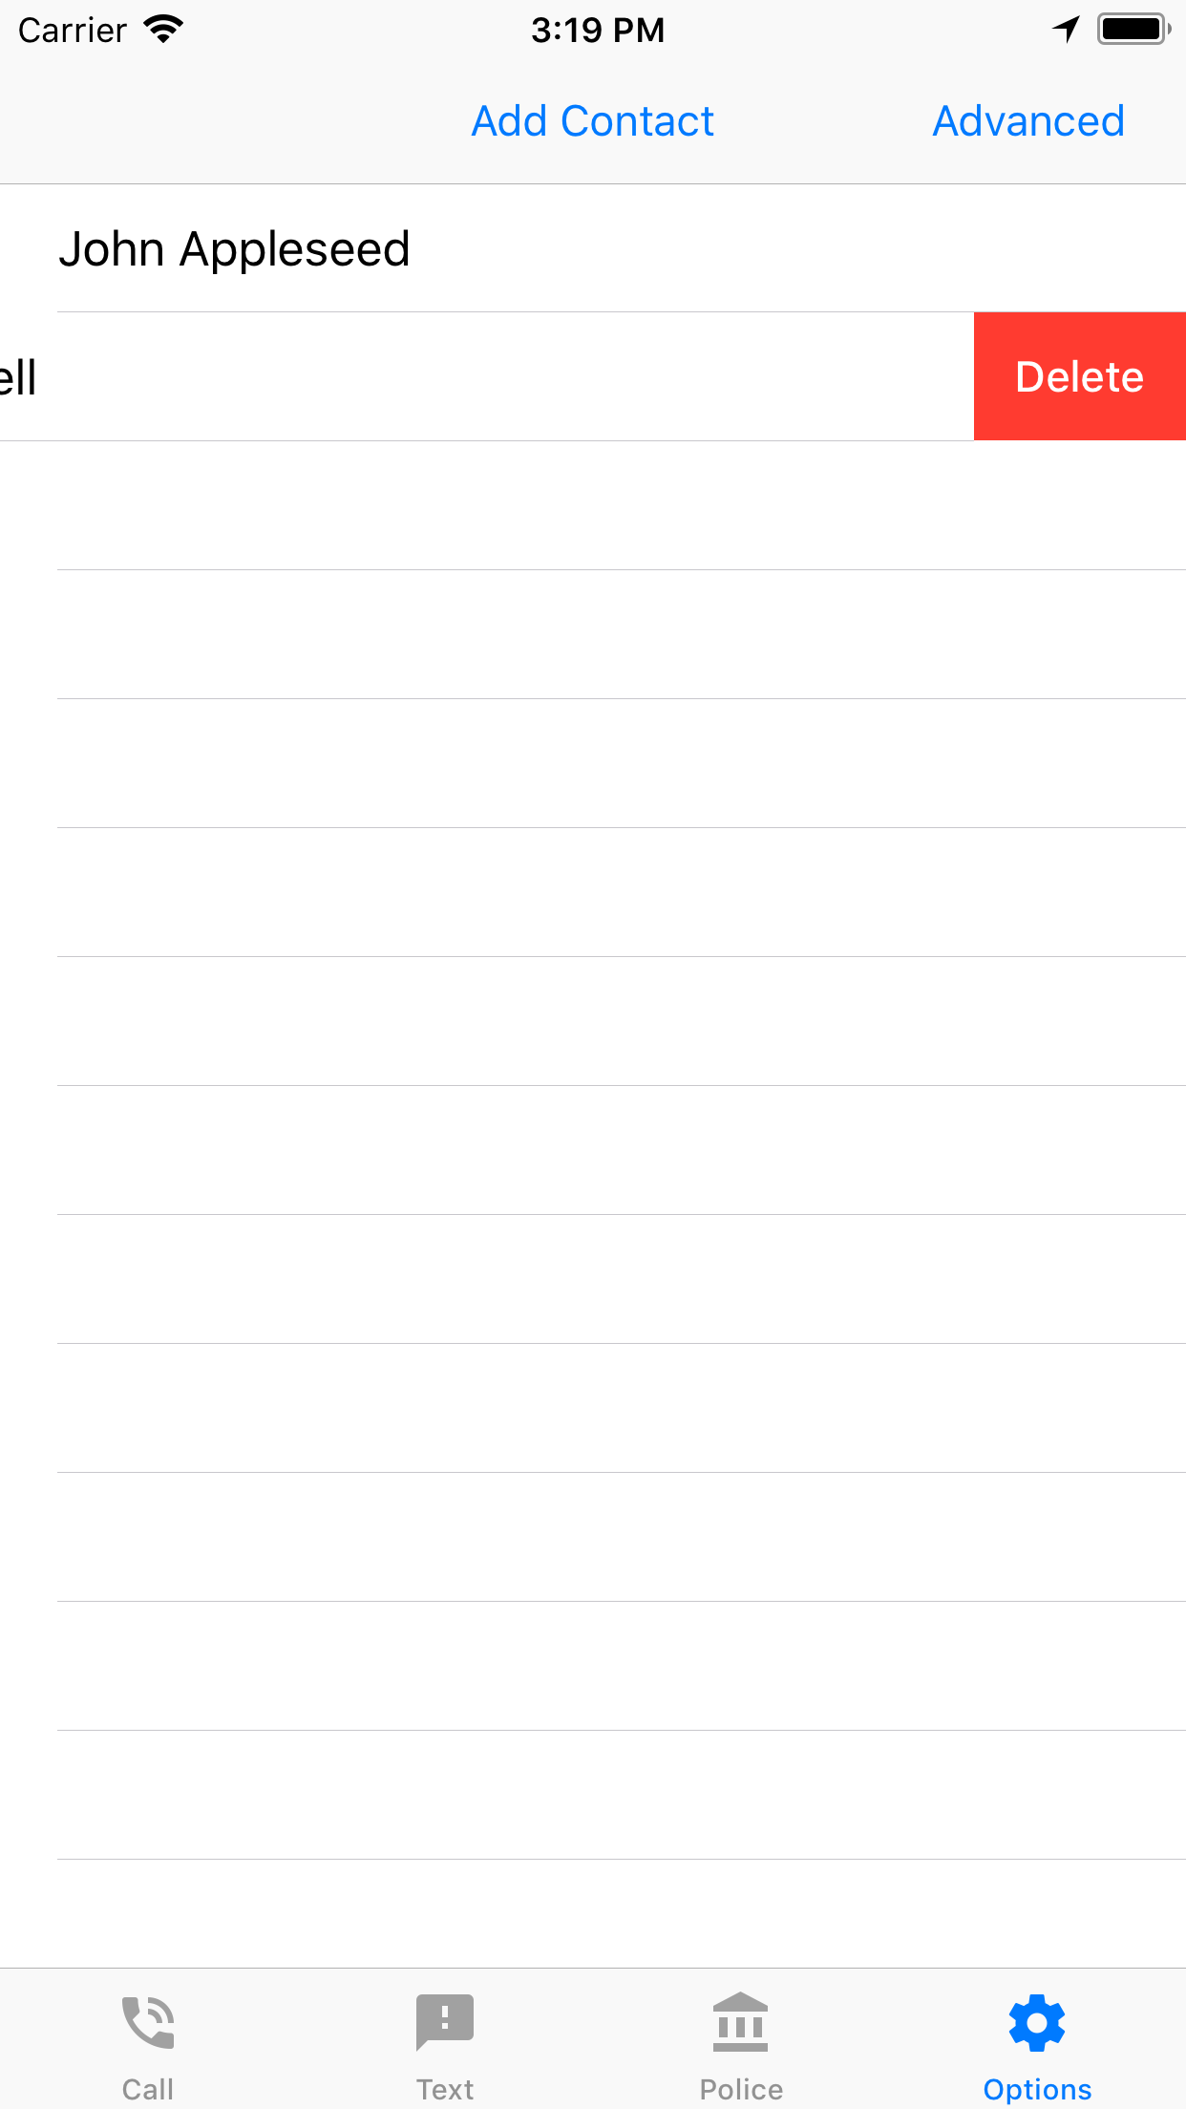

Slide 9
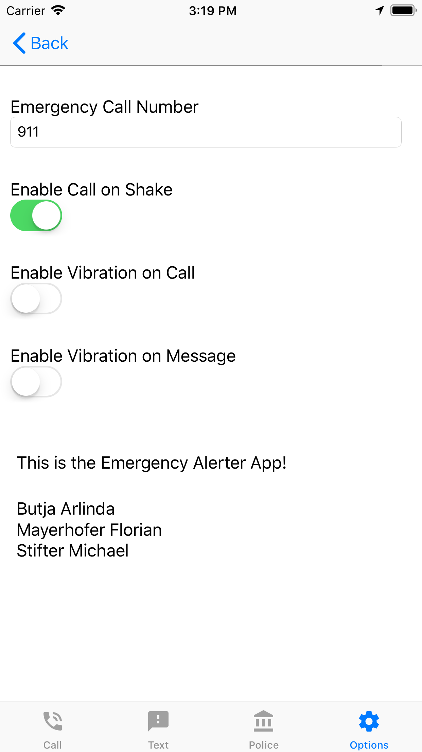
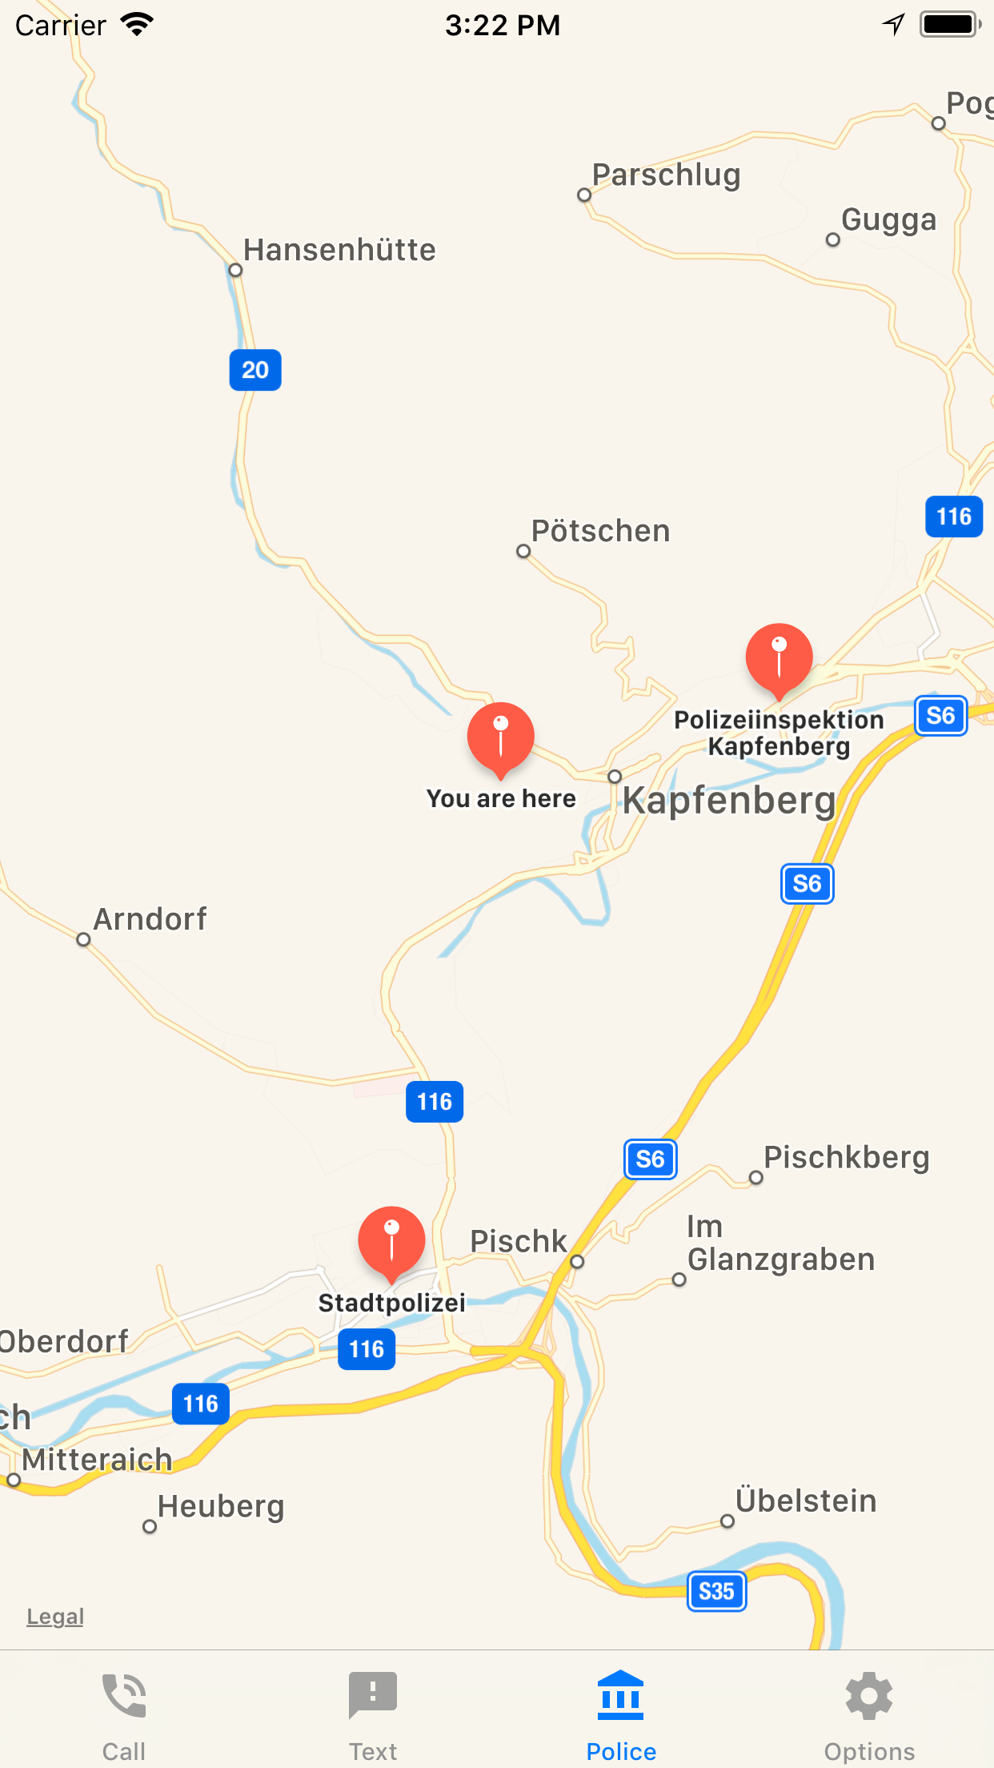

Slide 10
Live Demo

Slide 11
Thank you for your attention

